Slide 1
Econ 106 Lecture 18
slides adapted from: https://github.com/dlab-berkeley/R-Geospatial-Fundamentals/tree/master/docs
https://datacarpentry.org/r-raster-vector-geospatial/index.html

Slide 2
Updates
MS #3 is due Sunday, 11:59pm
No class on Wednesday
Week 10: Visualization for Communication
https://pollev.com/vsovero

Slide 3
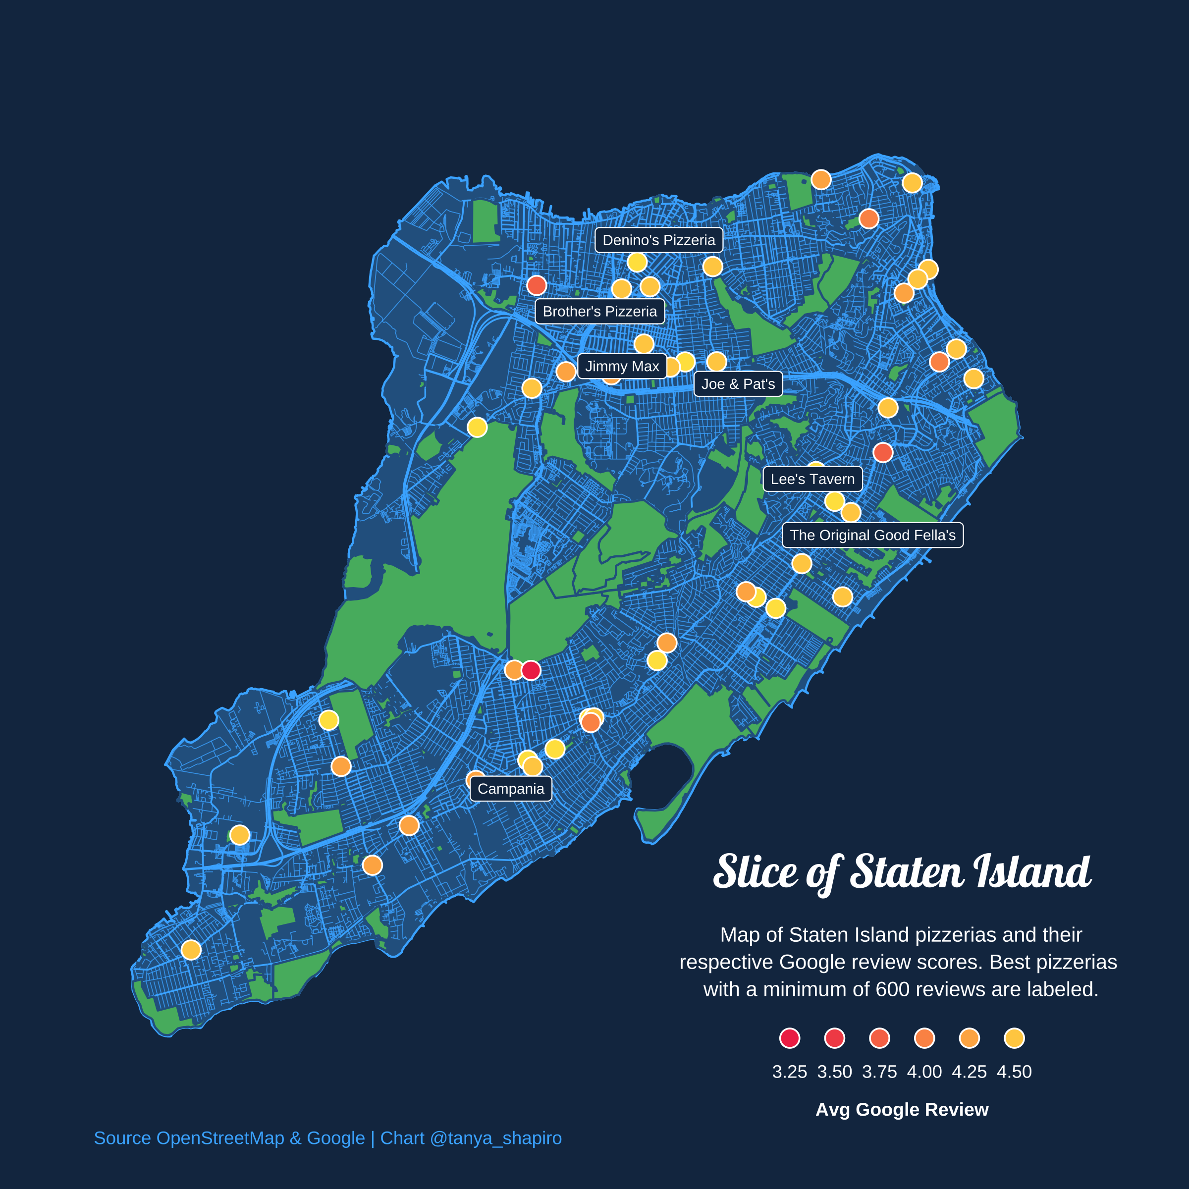
#30DayMapChallenge
On the map:
locations of pizzerias (points)
road network
parks
https://www.tanyashapiro.com/more/30daymapchallenge

Slide 4
Outline for today
loading maps from TIGRIS
Annotations
Map projections
Spatial Queries:
measuring area
measuring distance

Slide 5
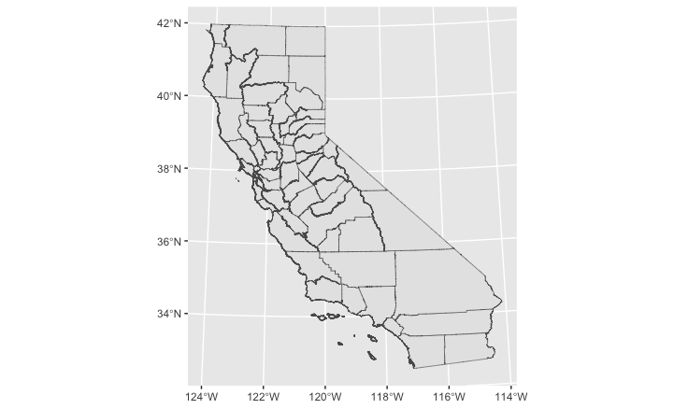
Recap: Map of California Counties
We read in a shapefile (CA_Counties) using st_read()
We plot sf objects using geom_sf()
ggplot(data=CA_Counties) +
geom_sf()

Slide 6
Need a Map of the US?
The US Census Bureau has a large collection of geographies of the United States:
state
county
census tract
and so on

Slide 7
Need a Map of the US?
We can use the tigris package to load the data directly into R
library(tigris)

Slide 8
tigris package
Choose the function name that corresponds to the geography you want (list available here)
Arguments:
If you don’t want all the US, specify the State and/or county
Output: a sf object with California counties
library(tigris)
CA_Counties_Tigris<-counties("California")

Slide 9
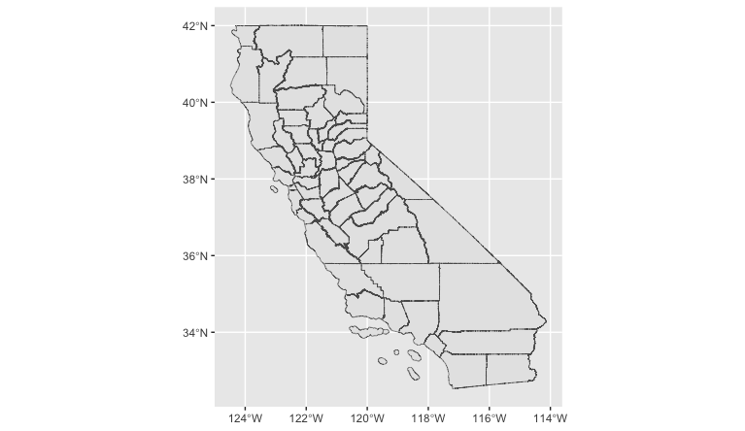
Map of California Counties
ggplot(data=CA_Counties_Tigris) +
geom_sf()
We can map this data using ggplot() and geom_sf() because it’s a sf object

Slide 10
Borders for United States and Territories
Leave the argument blank if you want geography for the entire US
US_States_Tigris<-states()

Slide 11
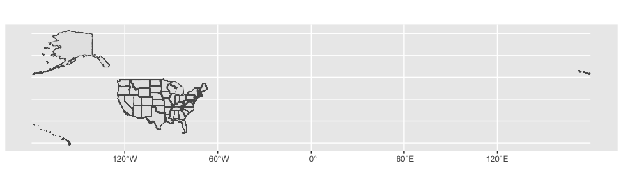
Map of the United States and Territories
Map doesn’t look great because it includes US territories
ggplot(data=US_States_Tigris) +
geom_sf()

Slide 12
Map of the United States
We can filter out territories (region 9)
It’s also helpful to relocate the non-contiguous states
only_states <- US_States_Tigris%>%
filter(REGION != "9") %>%
shift_geometry()

Slide 13
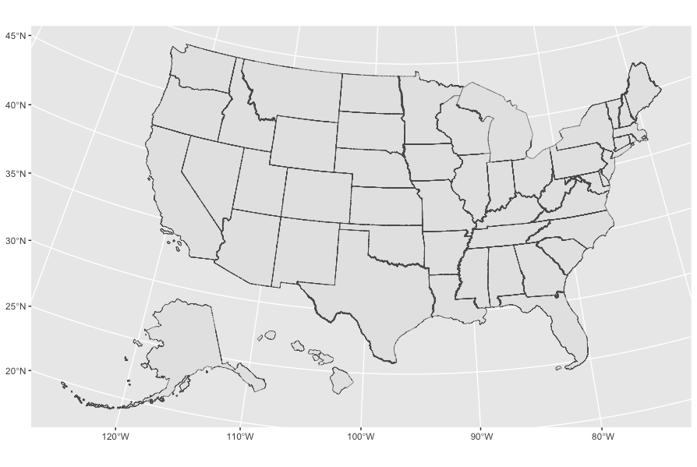
Map of the United States
ggplot(data=only_states) +
geom_sf()

Slide 14
Annotations for sf
geom_sf_label() – add annotations to a geom_sf
Arguments:
label
Remember to use aes() when referencing variable names
ggplot(data=only_states) +
geom_sf()+
geom_sf_label(aes(label=STUSPS))

Slide 15
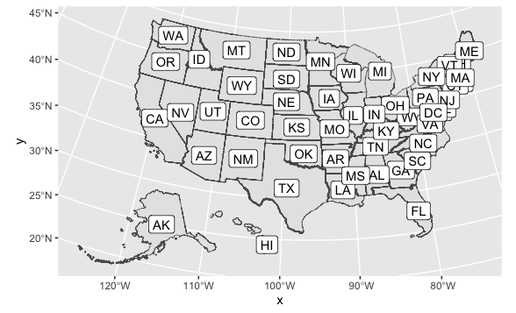

Slide 16
Class Exercise
create a data frame of the Los Angeles school district in California
create a data frame of CSU campuses in Los Angeles county
create a data frame of Los Angeles County
Plot all three on a map:
Los Angeles county
LAUSD (purple)
CSU’s (green)
https://pollev.com/vsovero

Slide 17
Spot the Differences
ggplot(data=CA_Counties) +
geom_sf()
ggplot(data=CA_Counties_Tigris) +
geom_sf()

Slide 18
Coordinate Reference System
The maps look different because the geometries use different coordinate reference systems.
Notes:
So Geospatial Data is a location that is given by a set of coordinates. Anatone WA has specific coordinates associated with its location, a latitude and a longitude. The specific values we use to answer the question of “where” can differ by the coordinate reference system we use.

Slide 19
Coordinate Reference Systems (CRS)
A CRS describes how the coordinates in a geospatial dataset relate to locations on the surface of the earth.
A geographic CRS uses a 3D model of the shape of the earth
A projected CRS consists of:
a geographic CRS
a specific map projection used to transform geographic coordinates from a curved to a flat surface
Notes:
GCS are actually quite popular and as you become more familiar with geospatial data and work with different datasets, two CRS you will probably run into are WGS84 and NAD83.
Why do you think people will use different CRS for different places or reasons? Sometimes different CRS work better in one location rather than another. NAD83 is actually great to use if you’re looking at the US. Those 4 digit numbers you see next to NAD83 is the EPSG code. These codes are what you’ll be using in Python and R to designate a specific CRS.

Slide 20
Common Projections
Web Mercator (3857)
Preserves direction/angle/shape but distorts area and distance.
U.S. National Atlas (Albers) Equal Area (2163)
Preserves area but distorts direction/angle/shape and distance.
California (Albers) Equal Area (3310)
Equal Area projection optimized to California
Preserves area but distorts direction/angle/shape and distance.

Slide 21
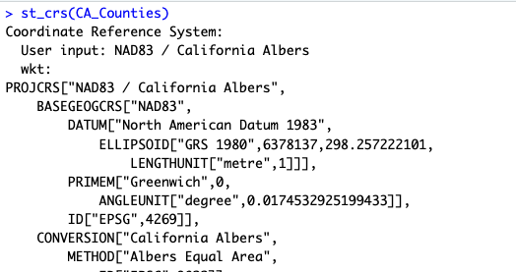
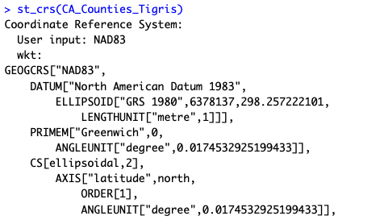
Checking the CRS
We can use st_crs() to check the CRS
CA_Counties uses a projected CRS:
geographic CRS: NAD83
projection: California Albers
CA_Counties_Tigris uses a geographic CRS: NAD83

Slide 22
Transforming the CRS
To change a CRS, we need to project (or re-project) our data using st_transform()
Arguments:
The sf object
The CRS (four digit code)
CA_Counties_Tigris_Mercator<-st_transform(CA_Counties_Tigris, crs=3857)

Slide 23
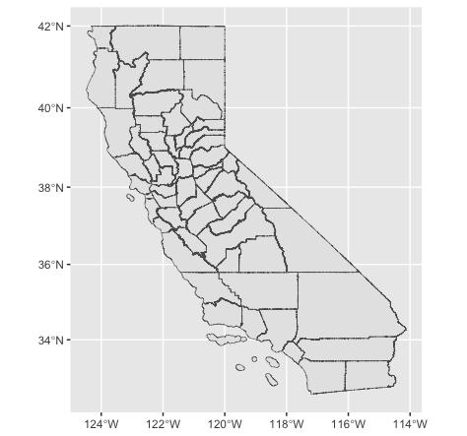
Mercator Projection
CA_Counties_Tigris_Mercator<-st_transform(CA_Counties_Tigris, crs=3857)
ggplot(data=CA_Counties_Tigris_Mercator) +
geom_sf()
Notes:
So Geospatial Data is a location that is given by a set of coordinates. Anatone WA has specific coordinates associated with its location, a latitude and a longitude. The specific values we use to answer the question of “where” can differ by the coordinate reference system we use.

Slide 24

CA Albers Projection
CA_Counties_Tigris_Albers_CA<-st_transform(CA_Counties_Tigris, crs=3310)
ggplot(data=CA_Counties_Tigris_Albers_CA) +
geom_sf()
Notes:
So Geospatial Data is a location that is given by a set of coordinates. Anatone WA has specific coordinates associated with its location, a latitude and a longitude. The specific values we use to answer the question of “where” can differ by the coordinate reference system we use.

Slide 25
Class Exercise
Transform LA county to the Mercator Projection
Transform LA county to the Albers Projection

Slide 26
Beyond Mapping: Spatial Queries
Queries are software operations that allow us to ask questions of our data and which return data metrics, subsets or new data objects.
The basic types of spatial queries are:
Spatial Measurement Queries
Spatial Relationship Queries

Slide 27
Beyond Mapping: Spatial Queries
Spatial Measurement Queries
What is feature A’s area?
What is the area of Alameda County?
What is feature A’s length?
What is the length of the BART train line between Walnut Creek and Rockridge?
What is feature A’s distance from feature B?
What is the distance between Berkeley High School and Berkeley BART Station?
Spatial Relationship Queries
Is feature A within feature B?
What schools are in Berkeley?
Does feature A intersect with feature B?
*What in what cities is Tilden Regional Park located?
Does feature A cross feature B?
Does the BART line cross into Albany?

Slide 28
Measuring Area
We will use st_area() to calculate the area of Riverside County
Arguments:
the sf object
Output: area printed to the console
st_area(Riverside_County_Albers)
18921433643 [m^2]

Slide 29
Area Measurements under different Projections
The calculated area of Riverside county is very different depending on the CRS
Albers: distorts shape, preserves area and distance
Mercator: preserves shape, distorts area and distance
st_area(Riverside_County_Albers)
18921433643 [m^2]
st_area(Riverside_County_Mercator)
27426748703 [m^2]

Slide 30
Changing the units
The default unit of measurement is square meters
we can use set_units() from the units package to change the unit of measurement to square miles
Arguments:
the measure you want converted
the unit of measurement
Output: Area of Riverside County in square miles
set_units(st_area(Riverside_County_Albers), mi^2)
7303.084 [mi^2]

Slide 31
Class Exercise
Calculate the area of LA county in the Mercator Projection (sq miles)
Calculate the area of LA county to the Albers Projection (sq miles)
https://pollev.com/vsovero

Slide 32
Measuring Distance
What is the distance between UCR and CSU San Bernadino?
First, make sure that your simple features (UCR and CSUSB are using the same CRS (CA Albers)
CSUSB<-CSU_sf%>%
filter(IALIAS=="Cal State San Bernardino")
CSUSB_Albers<-st_transform(CSUSB, crs=3310)

Slide 33
Measure Distance
we will use st_distance() to measure distance between two sf objects
st_distance(UCR_Albers, CSUSB_Albers)
Units: [m]
[,1]
[1,] 23316.02
set_units(st_distance(UCR_Albers, CSUSB_Albers),mi)
Units: [mi]
[,1]
[1,] 14.48791

Slide 34
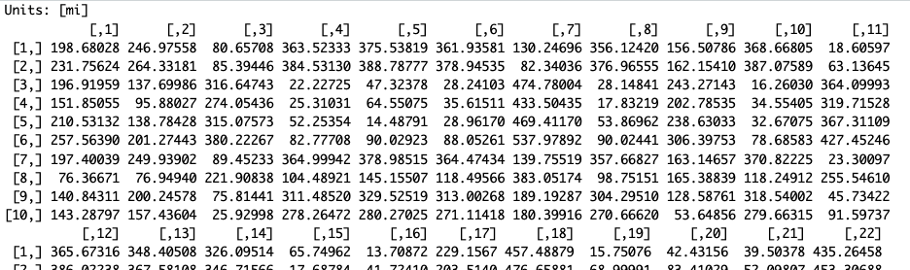
Measuring Distance between all the UC’s and all the CSU’s
Can we do it? Sure.
Output will be a matrix of all the pairwise combinations of UC’s and CSU’s
Hard to read the output that’s printed to the console
CSU_Albers<-st_transform(CSU_sf, crs=3310)
UC_Albers<-st_transform(UC_sf, crs=3310)
set_units( st_distance(UC_Albers, CSU_Albers),mi)

Slide 35
Measuring Distance between UC’s and CSU’s
First, save our output to an object (distance_matrix)
Next, assign the names of the schools to the rows and columns
Finally, save it as a data frame
distance_matrix<-set_units( st_distance(UC_Albers, CSU_Albers) , mi)
rownames(distance_matrix)=c(UC_Albers$INSTNM)
colnames(distance_matrix)=c(CSU_Albers$INSTNM)
distance_data<-data.frame(distance_matrix)

Slide 36
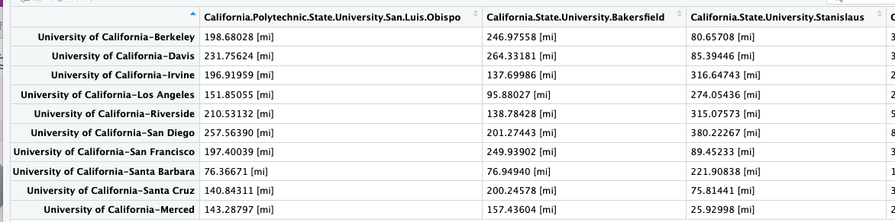
Measuring Distance between UC’s and CSU’s
distance_matrix<-set_units( st_distance(UC_Albers, CSU_Albers) , mi)
rownames(distance_matrix)=c(UC_Albers$INSTNM)
colnames(distance_matrix)=c(CSU_Albers$INSTNM)
distance_data<-data.frame(distance_matrix)

Slide 37
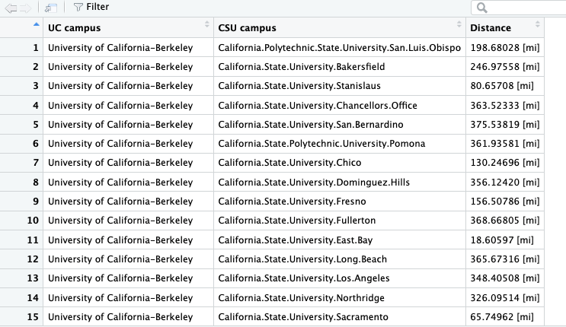
Make it Tidy
Things you will need to use:
row_names_to_columns()
pivot_longer()

Slide 38
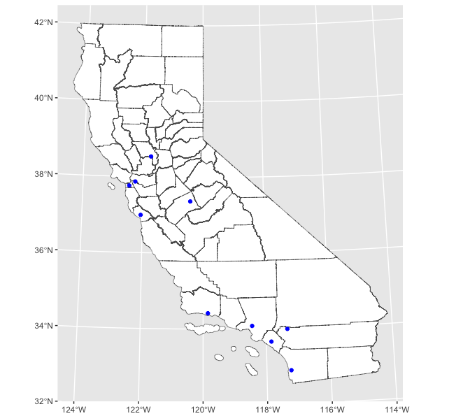
Measuring Distance between Counties and UC Campuses
Let say we wanted to measure the distance between every county in California and every UC campus
Problem: Distance needs to be measured between two points, counties are polygons
What do we do?

Slide 39
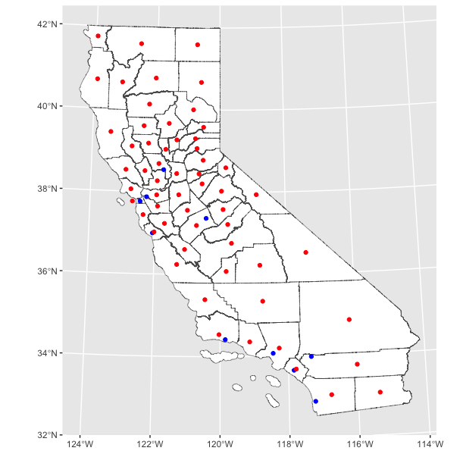
Measuring Distance between Counties and UC Campuses
Problem: Distance needs to be measured between two points, counties are polygons
Solution: find the centroid (center) of each county
Blue: UC Campuses
Red: County Centroids

Slide 40
County Centroids
CA_Counties_Centroids<-st_centroid(CA_Counties_Tigris_Albers_CA)
We will use st_centroid() to find the centroid of each county
Arguments: a simple features object (polygons)
Output: a simple features object (points)

Slide 41
Class Exercise
Create a data frame that measures the distance between every county centroid and every UC campus
What is the distance of LA county to all of the UC campuses?
How many campuses are within 100 miles of the centroid of LA County?
https://pollev.com/vsovero

